Slide 1
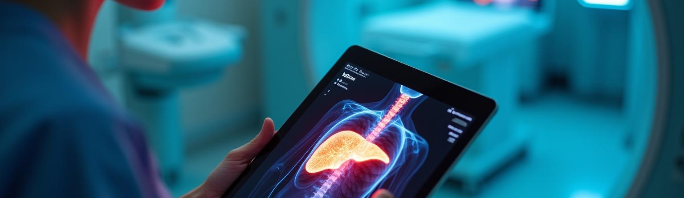
Liver Cirrhosis Detection
Month
Exploring AIML Techniques for Effective Diagnosis
00th

Slide 2
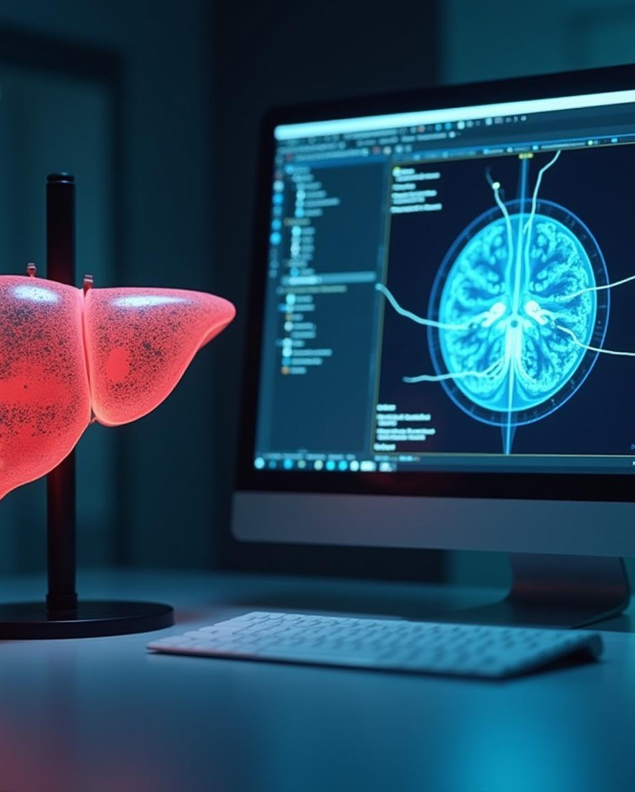
Introduction
Liver cirrhosis is a severe condition involving liver damage. Early detection is crucial for better patient outcomes. This presentation explores the integration of Artificial Intelligence and Machine Learning (AIML) methods to enhance the detection process. By leveraging advanced data analysis techniques, healthcare professionals can improve diagnostic accuracy and efficiency.

Slide 3
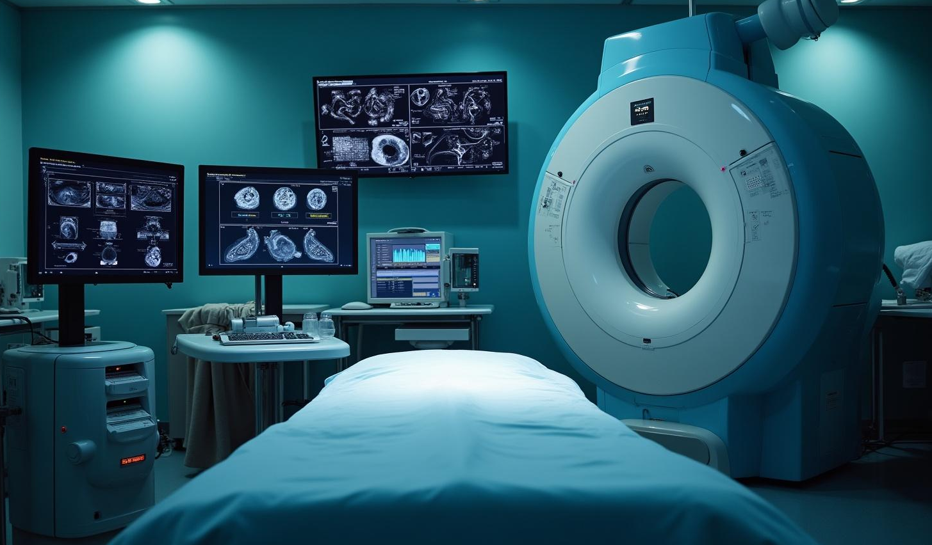
01
Detection Methods

Slide 4
Traditional Diagnosis Techniques
Traditional diagnosis of liver cirrhosis includes methods like blood tests, imaging studies (ultrasound, CT scan), and liver biopsy. Each technique plays a vital role in assessing the extent of liver damage and guiding treatment plans. However, these methods can be invasive and time-consuming, leading to delays in diagnosis.

Slide 5
AIML Approaches in Detection
AIML techniques offer innovative solutions for liver cirrhosis detection. Utilizing algorithms for pattern recognition and predictive analysis, AIML can process large datasets with efficiency. These techniques not only enhance the accuracy of early diagnosis but also reduce the reliance on invasive procedures, thus streamlining patient care.

Slide 6

Comparison of Methods
Comparing traditional methods with AIML approaches reveals significant advantages. Traditional methods may provide accurate results, but they often require significant time and resources. In contrast, AIML algorithms can analyze patient data quickly, highlighting patterns indicative of liver cirrhosis. This comparison underscores the importance of integrating AIML techniques to enhance early detection capabilities.

Slide 7

02
Data Analysis

Slide 8
Data Collection for AIML
Effective data collection is paramount for successful AIML implementation in liver cirrhosis detection. This involves gathering comprehensive datasets, including patient demographics, clinical history, lab results, and imaging data. Ensuring the quality and diversity of the data is crucial for training robust AIML models that can accurately predict liver cirrhosis outcomes.

Slide 9

Using Charts for Visualization
Charts and graphical representations play a vital role in data analysis for liver cirrhosis detection. They provide intuitive insights into trends, such as the progression of liver damage over time. Visualizations help stakeholders understand complex data patterns and facilitate informed decision-making by summarizing key findings in a digestible format.

Slide 10
Challenges and Solutions
Implementing AIML technologies in liver cirrhosis detection poses challenges, including data privacy concerns and the need for high-quality datasets. Additionally, integrating AIML solutions within existing healthcare systems can be complicated. Solutions include ensuring compliance with data protection regulations, developing standardized protocols for data collection, and providing training for healthcare professionals on using these advanced technologies effectively.

Slide 11
Conclusions
The integration of AIML techniques into liver cirrhosis detection offers considerable benefits in terms of speed and accuracy. By harnessing the power of data analysis and visualization, healthcare providers can make more informed decisions, leading to improved patient outcomes. Addressing the challenges associated with implementation will enhance the effectiveness of these innovative approaches in clinical settings.

